Slide 1
Structured Programming Methodology (SPM)
First Year -AY 2025-26

Slide 2
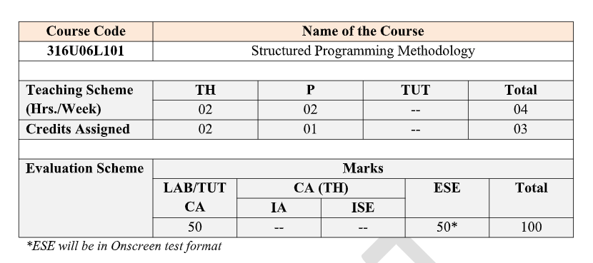
Structured Programming Methodology(SPM)
Syllabus

Slide 3
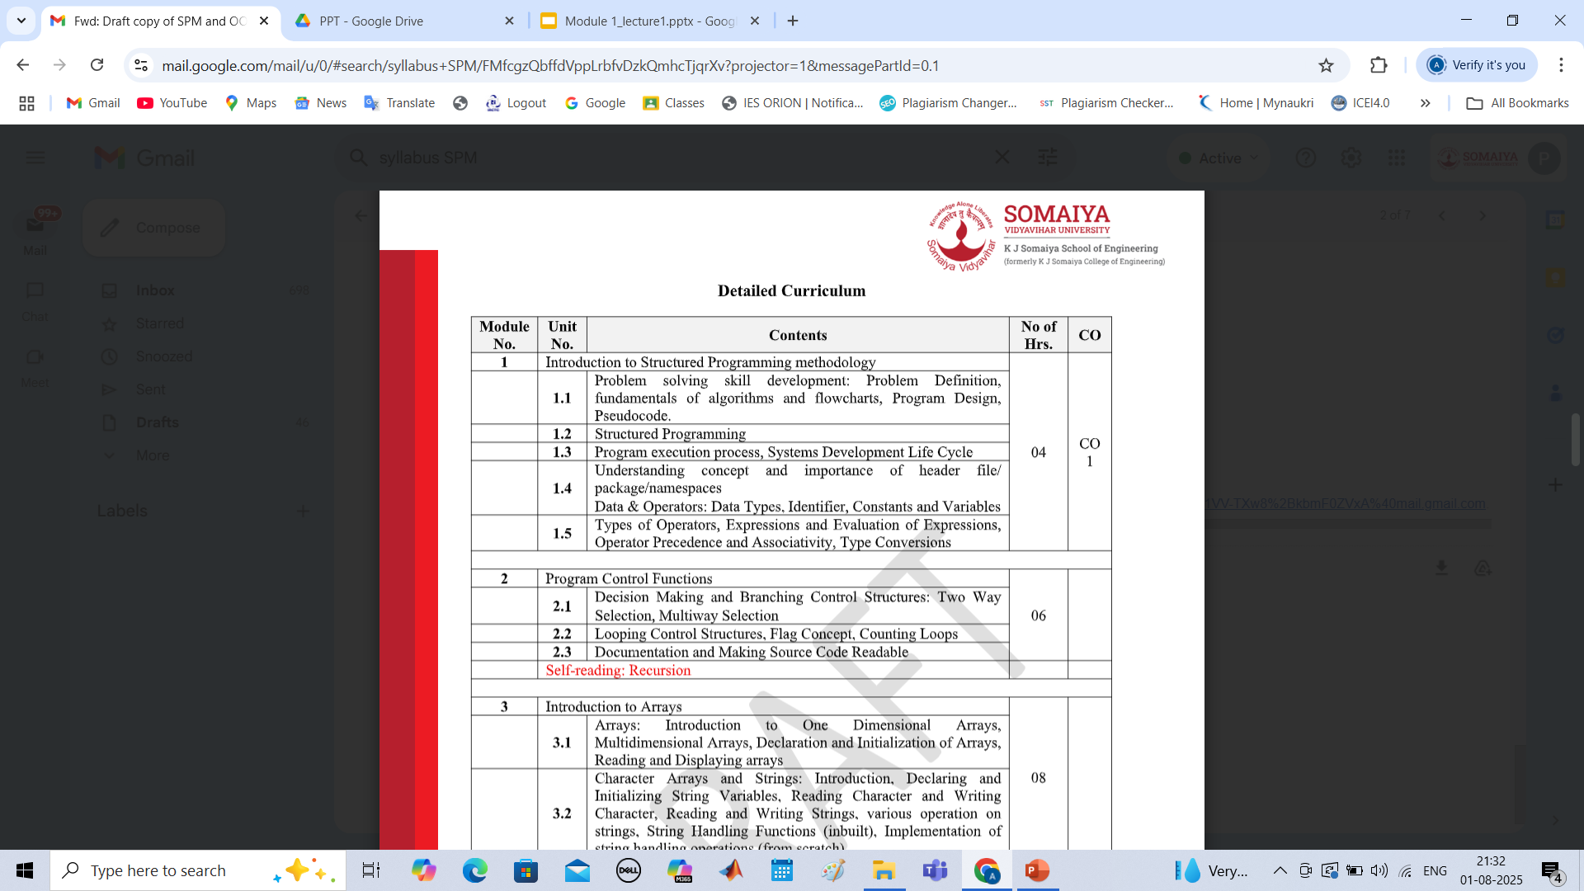
Structured Programming Methodology(SPM)
Syllabus

Slide 4
What is Programming?
  Giving instructions to a computer to perform a task
  Why do we program?
    To automate tasks, solve problems

Slide 5
Introduction to Problem Solving
Methodology
  It's a systematic approach
  Steps:
Define Problem -> Analyze -> Design -> Implement
-> Test -> Maintain

Slide 6
Introduction to Structured Programming Methodology
Problem solving skill development:
    Problem Definition
    Fundamentals of algorithms and flowcharts
    Program Design
    Pseudocode

Slide 7
Structured Programming Overview
Definition
Structured programming is a programming paradigm aimed at improving the clarity, quality, and development time of computer programs by using well- defined control structures and subroutines.
Structured programming is a programming paradigm that emphasizes clear program structure using sequence, selection, and iteration control structures.
Core Principles
Top-down design approach breaks complex problems into manageable modules. Programs use only three control structures: sequence (sequential execution), selection (if-then-else), and iteration (loops). This methodology promotes code readability, maintainability, and reduces programming errors through systematic design and implementation practices.
Example: Control Flow in Structured Programming
Sequence
Selection
Iteration
Step by step
if/then/else
Loops

Slide 8
Problem Solving Skills
Essential Development Strategies
1.Understanding the Problem Domain
Analyze requirements thoroughly, identify input-output relationships, understand constraints and limitations, and clarify ambiguous specifications before proceeding with solution design.
2.Breaking Down Complex Problems
Decompose large problems into smaller, manageable subproblems using divide-and-conquer approach, identify common patterns, and establish clear problem boundaries.
3.Critical Thinking and Logic Development
Develop logical reasoning skills, practice pattern recognition, learn to trace through problem scenarios, and build systematic approaches to solution validation and testing.

Slide 9



Importance of Problem-Solving in Programming
Problem-solving is the core skill in programming. It involves the ability to understand a problem, devise a plan, and implement a solution through code that satisfies all constraints.
Why It Matters:
Programming is essentially problem-solving with code as the tool
Core Aspects:
Analytical Thinking: Breaking problems into manageable parts
Technical skills evolve, but problem-solving remains constant
Pattern Recognition: Identifying similarities with known solutions
Differentiates exceptional developers from average ones
Creative Solutions: Finding novel approaches to difficult problems
Enables adaptation to new languages and paradigms
Debugging Skills: Identifying and fixing errors systematically
Directly impacts code efficiency and optimization
"Problem solving is writing an original program that performs a particular set of tasks and meets all stated constraints." — V. Anton Spraul, "Think Like a Programmer"
Define requirements
Algorithms & flowcharts
Write & test solution
Understand Problem
Plan Solution
Implement Code

Slide 10
Problem Definition
Systematic approach to problem analysis
Problem Analysis
Clearly define what needs to be solved by identifying the problem statement, understanding input requirements, and specifying expected outputs. Determine constraints, limitations, and performance requirements. Analyze edge cases and special conditions that may affect the solution approach.
Requirements Specification
Document functional requirements including what the program should do, non-functional requirements such as performance and usability criteria, and system constraints. Establish acceptance criteria for solution validation and create test scenarios to verify correctness of the final implementation.

Slide 11
The Problem-Solving Process
Effective problem-solving in programming involves a structured approach with three main stages. Mastering this process is fundamental to developing efficient and correct programs.
1
Understanding
2
Planning
3
Dividing
Define the problem clearly
Design the interface
Break into subproblems
Restate in plain language
Determine data structures
Start with simplest parts
Identify inputs and outputs
Sketch an algorithm
Solve incrementally
Draw diagrams if helpful
Write pseudocode
Test each component
Verify comprehension
Evaluate approaches
Combine solutions
The Problem-Solving Cycle in Action
Understanding
Define & clarify requirements
Planning
Design algorithm & pseudocode
Dividing
Solve components incrementally
Iterate through the process as needed for complex problems
Slide 11 | Introduction to Structured Programmin^{M}g ªMdee^{w}t^{i}h^{th}o^{G}d^{e}o^{n}l^{s}o^{p}g^{ar}y^{k}

Slide 12
Fundamentals of Algorithm
The word “algorithm” relates to the name of the mathematician Al-khowarizmi, which means a procedure or a technique. Software Engineer commonly uses an algorithm for planning and solving the problems. An algorithm is a sequence of steps to solve a particular problem or algorithm is an ordered set of unambiguous steps that produces a result and terminates in a finite time.
Algorithm has the following characteristics:
Input: An algorithm may or may not require input
Output: Each algorithm is expected to produce at least one result
Definiteness: Each instruction must be clear and unambiguous.
Finiteness: If the instructions of an algorithm are executed, the algorithm should terminate after finite number of steps

Slide 13
Fundamentals of Algorithm
The algorithm and flowchart include following three types of control structures.
Sequence: In the sequence structure, statements are placed one after the other and the execution takes place starting from up to down.
Branching (Selection): In branch control, there is a condition and according to a condition, a decision of either TRUE or FALSE is achieved. In the case of TRUE, one of the two branches is explored; but in the case of FALSE condition, the other alternative is taken. Generally, the ‘IF-THEN’ is used to represent branch control.
Loop (Repetition): The Loop or Repetition allows a statement(s) to be executed repeatedly based on certain loop condition e.g. WHILE, FOR loops
Advantages of algorithm:
    • It is a step-wise representation of a solution to a given problem, which makes it easy to understand.
    • An algorithm uses a definite procedure.
    • It is not dependent on any programming language, so it is easy to understand for anyone even without programming knowledge.
    • Every step in an algorithm has its own logical sequence so it is easy to debug.

Slide 14
HOW TO WRITE ALGORITHMS
Step 1 Define your algorithms input: Many algorithms take in data to be processed, e.g. to calculate the area of rectangle input may be the rectangle height and rectangle width.
Step 2 Define the variables: Algorithm's variables allow you to use it for more than one place. We can define two variables for rectangle height and rectangle width as HEIGHT and WIDTH (or H & W). We should use meaningful variable name e.g. instead of using H & W use HEIGHT and WIDTH as variable name.
Step 3 Outline the algorithm's operations: Use input variable for computation purpose, e.g. to find area of rectangle multiply the HEIGHT and WIDTH variable and store the value in new variable (say) AREA. An algorithm's operations can take the form of multiple steps and even branch, depending on the value of the input variables.
Step 4 Output the results of your algorithm's operations: In case of area of rectangle output will be the value stored in variable AREA. if the input variables described a rectangle with a HEIGHT of 2 and a WIDTH of 3, the algorithm would output the value of 6.

Slide 15
Fundamentals of Algorithm
Example 1.
Suppose we want to find the average of three numbers, the algorithm is as follows
Step 1 Read the numbers a, b, c
Step 2 Compute the sum of a, b and c
Step 3 Divide the sum by 3
Step 4 Store the result in variable d
Step 5 Print the value of d
Step 6 End of the program

Slide 16
Fundamentals of Algorithm
Write an algorithm to calculate the simple interest using the formula. Simple interest = P*N* R/100.
Where P is principle Amount, N is the number of years and R is the rate of interest.
Step 1: Read the three input quantities’ P, N and R.
Step 2 : Calculate simple interest as Simple interest = P* N* R/100
Step 3: Print simple interest.
Step 4: Stop.

Slide 17
Fundamentals of Algorithm
2. Write an algorithm to find the largest of three numbers X, Y,Z.
Step 1: Read the numbers X,Y,Z.
Step 2: if (X > Y)
Big = X
else BIG = Y
Step 3 : if (BIG < Z)
Step 4: Big = Z
Step 5: Print the largest number i.e. Big
Step 6: Stop.

Slide 18
Fundamentals of Flowchart
A flow chart is a step by step diagrammatic representation of the logic paths to solve a given problem. Or A flowchart is visual or graphical representation of an algorithm. The flowcharts are pictorial representation of the methods to be used to solve a given problem and help a great deal to analyze the problem and plan its solution in a systematic and orderly manner. A flowchart when translated in to a proper computer language, results in a complete program.
Advantages of Flowcharts
The flowchart shows the logic of a problem displayed in pictorial fashion which felicitates easier checking of an algorithm.
The Flowchart is good means of communication to other users. It is also a compact means of recording an algorithm solution to a problem.
The flowchart allows the problem solver to break the problem into parts. These parts can be connected to make master chart.
The flowchart is a permanent record of the solution which can be consulted at a later time.

Slide 19
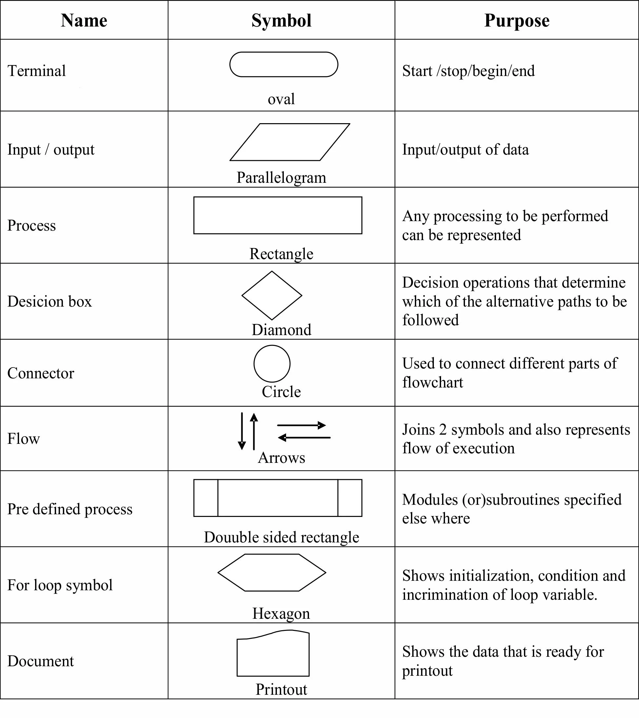
Symbols Used in Flowchart

Slide 20
Difference between flowchart and algorithm
Flowchart | Algorithm
Block by block information diagram representing the data flow. | Step by step instruction representing the process of any solution.
It is a pictorial representation of a process. | It is a stepwise analysis of the work to be done.
The solution is shown in a graphical format. | The solution is shown in a non-computer language like English.
Easy to understand as compared to the algorithm. | It is somewhat difficult to understand.
Easy to show branching and looping. | Difficult to show branching and looping.
Flowchart for a big problem is impractical. | The algorithm can be written for any problem.
Difficult to debug errors. | Easy to debug errors.
It is easy to make a flowchart. | It is difficult to write an algorithm as compared to a flowchart.

Slide 21
Read two numbers, add them, display result
  Algorithm:
                Start
                Read num1 as A
                Read num2 as B
                SUM = A + B
                Display SUM
                Stop

Slide 22
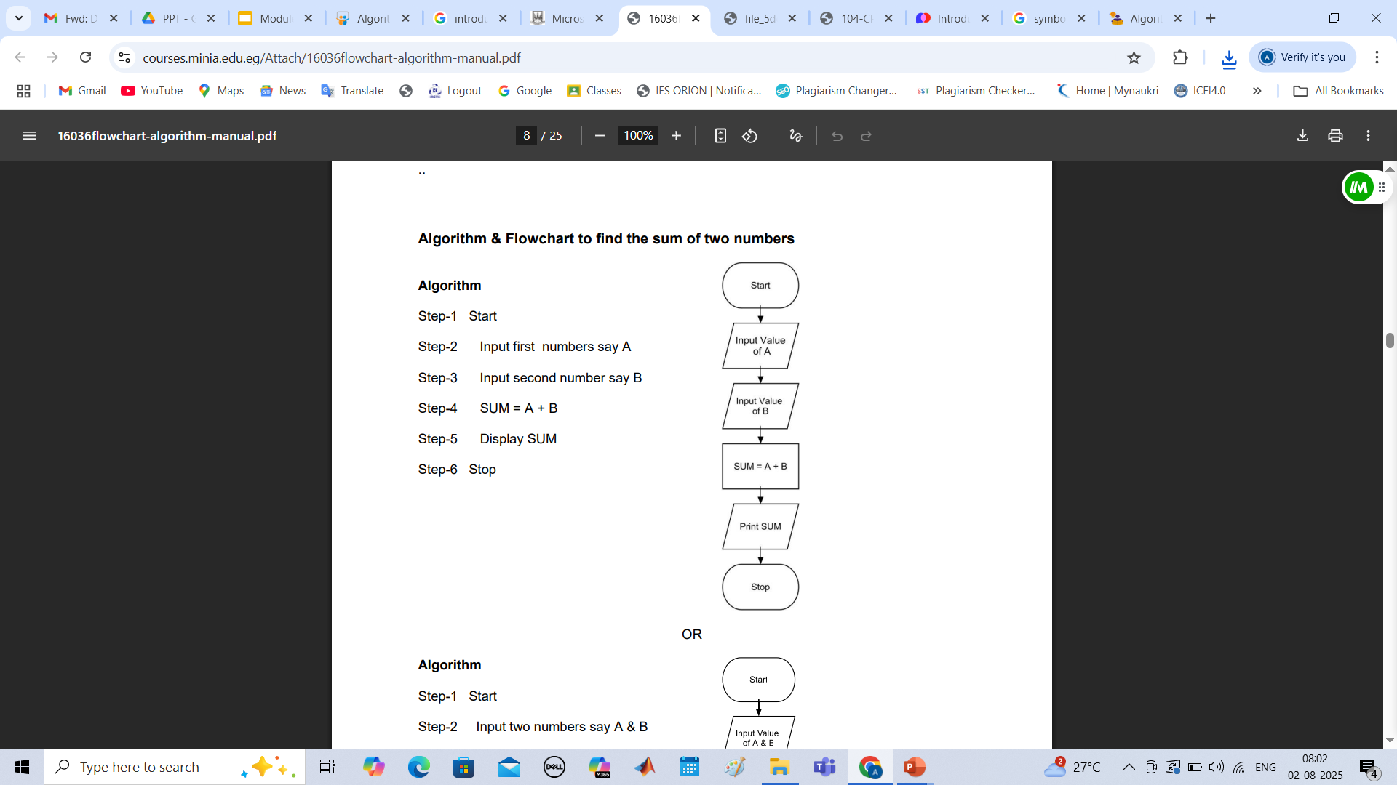
Flowchart

Slide 23
Example
Write an algorithm and draw a flowchart that will read the two sides of a rectangle and calculate its area.
Pseudocode
Input the width (W) and Length (L) of a rectangle
Calculate the area (A) by multiplying L with W
Print A

Slide 24
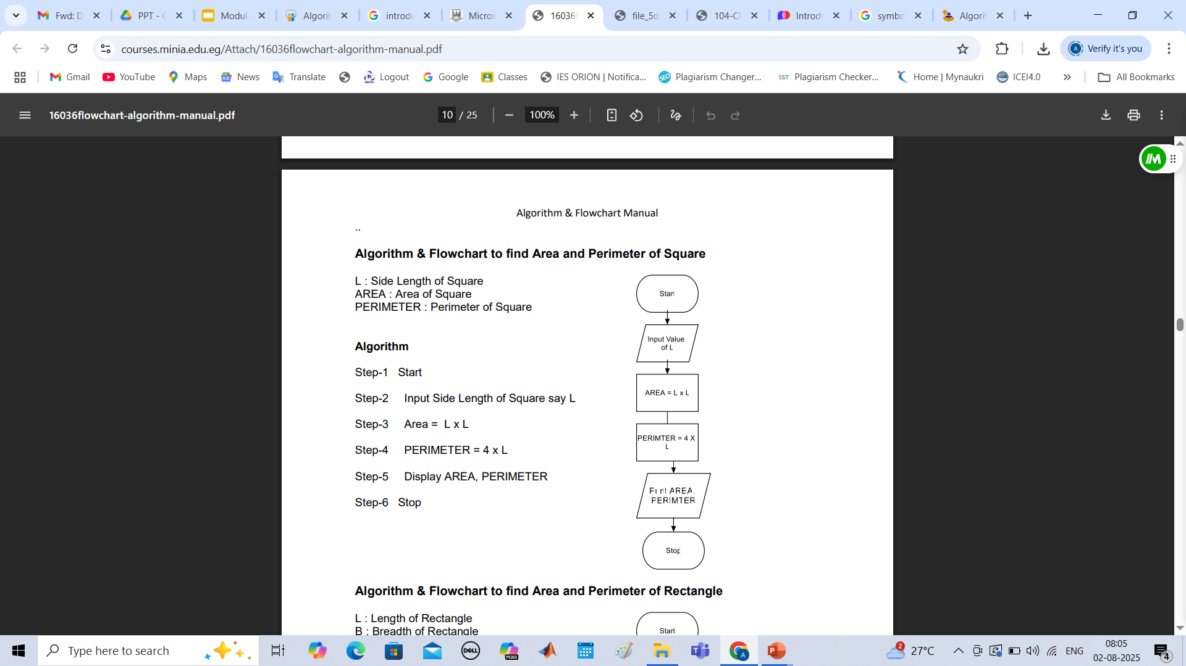
Flowchart

Slide 25
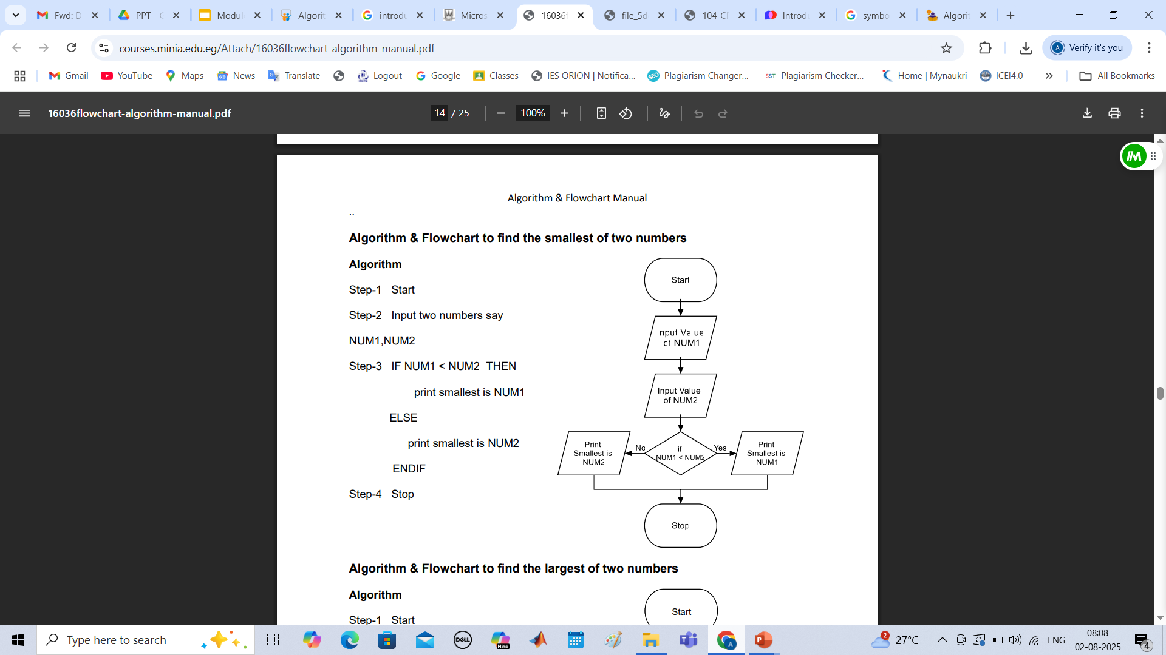
Flowchart
Example No.3

Slide 26
Example
Write an algorithm and draw a flowchart to convert the length in feet to centimeter.
Pseudocode:
Input the length in feet (Lft)
Calculate the length in cm (Lcm) by multiplying LFT with 30
Print length in cm (LCM)

Slide 27
Pseudo code
The Pseudo code is neither an algorithm nor a program. It is an abstract form of a program. It consists of English like statements which perform the specific operations. It is defined for an algorithm. It does not use any graphical representation. In pseudo code, the program is represented in terms of words and phrases, but the syntax of program is not strictly followed.
Advantages: * Easy to read, * Easy to understand, * Easy to modify.
Example: Write a pseudo code to perform the basic arithmetic operations.
Read n1, n2
Sum = n1 + n2
Diff = n1 – n2
Mult = n1 * n2
Quot = n1/n2
Print sum, diff, mult, quot
End.

Slide 28
Program Design in Structured Programming
Program Design in Structured Programming refers to a methodical and logical way of organizing code to make it clear, efficient, and easy to maintain. Structured programming follows a top-down approach and is based on the idea of breaking down a program into smaller, manageable sections called modules or functions.
Key Features of Program Design in Structured Programming
Top-Down Design
  Start from the main problem and break it down into smaller sub-problems.
  Each sub-problem becomes a module or function.
Modularity
  Divide the program into independent modules.
  Each module performs a specific task and can be tested separately.
Single Entry and Exit
  Each control structure (loop, condition, function) should have only one entry and one exit point, which avoids confusion and errors.
Use of Functions/Procedures
  Reusable blocks of code help in avoiding repetition and promote code reuse.
Control Structures
  Avoid goto statements.
  Use clear and limited control structures (sequence, selection, and iteration).
Benefits of Structured Program Design
✅ Easier to understand and maintain
✅ Code reusability through functions
✅ Simpler debugging and testing
✅ Better collaboration among programmers
✅ Encourages good programming practices

Slide 29
Program Design in Structured Programming
Example: Structured Program Design (C Language)
Let’s consider a simple problem: Calculate the average of three numbers
Step 1: Top-down design
Input three numbers
Calculate the average
Display the result
Step 2: Code
Summary
#include <stdio.h>
// Function to calculate average
float calculateAverage(int a, int b, int c) {
return (a + b + c) / 3.0;
}
int main() {
int num1, num2, num3;
float avg;
// Input
printf("Enter three numbers: ");
scanf("%d %d %d", &num1, &num2, &num3);
// Processing
avg = calculateAverage(num1, num2, num3);
// Output
printf("Average = %.2f\n", avg);
return 0;
}
Concept | Description
Approach | Top-down
Structure | Sequence, Selection, Iteration
Reusability | Through functions
Modularity | Break program into smaller components
Control Flow | No goto, clear entry/exit in functions

Slide 30
Thank You!

